Slide 1
Animal Shelter
Project by Christina Bolashikova, Celine Feyzova, Reneta Toplaska and Afra Yusrefova

Slide 2




Team participants
Christina Bolashikova
Celine Feyzova
Reneta Topalska
Afra Yusrefova

Slide 3
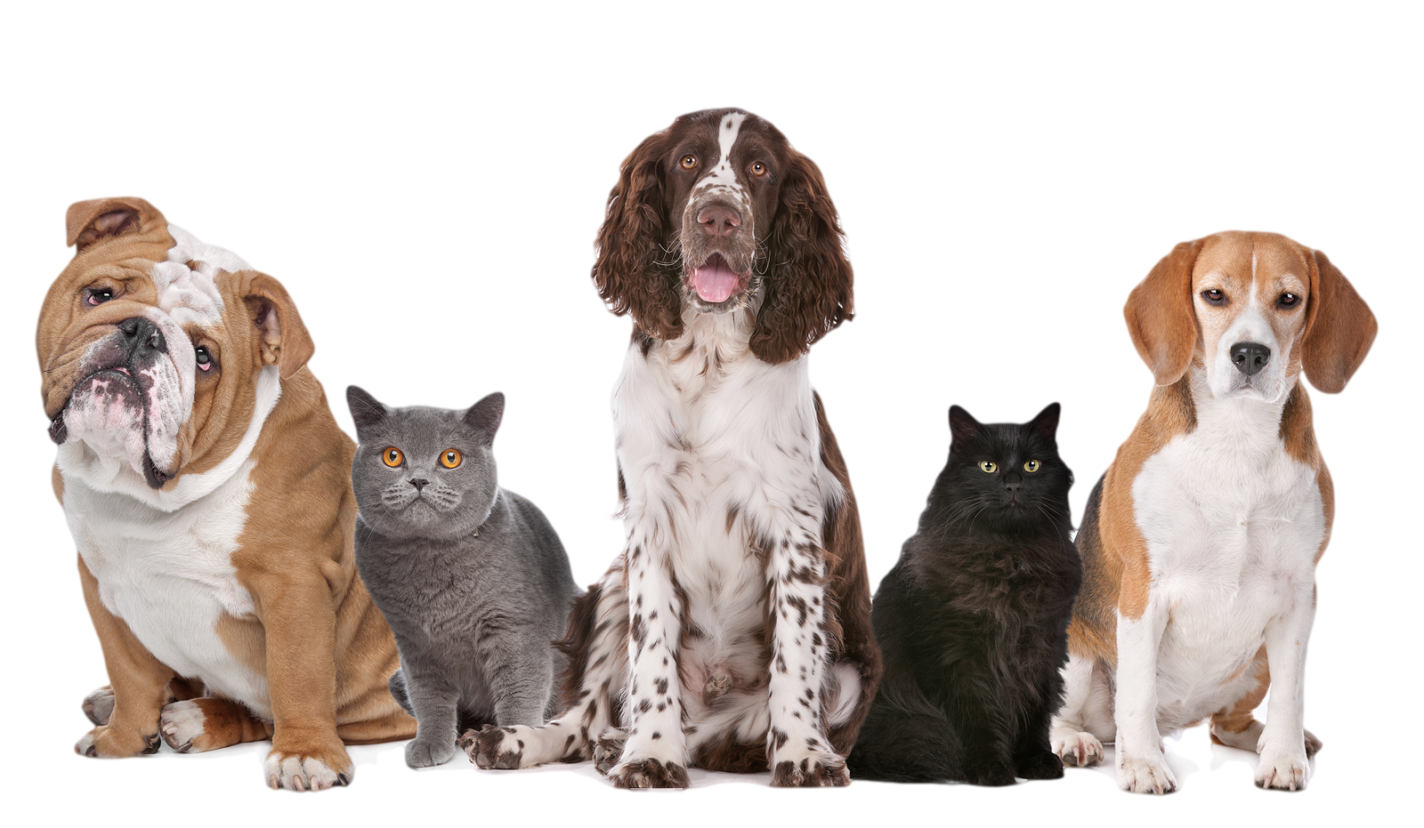
What's the main idea?
The main idea – to make the administrative work of the staff at an animal shelter easier and more precise
The program performs different actions such as adding, deleting, editing and displaying animals’ information, etc.
User-friendly and easy to navigate through

Slide 4




What did we use?
Visual Studio 2019
C++
GitHub
Microsoft Teams

Slide 5
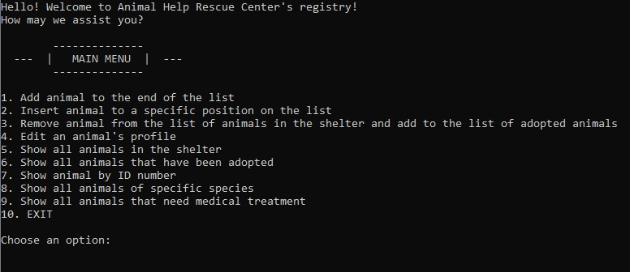
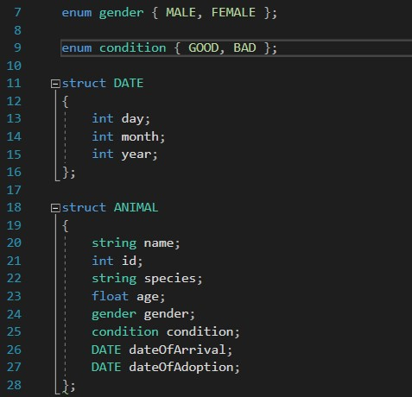
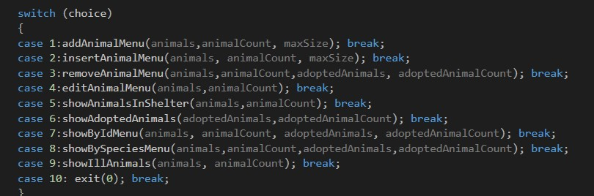

Slide 6
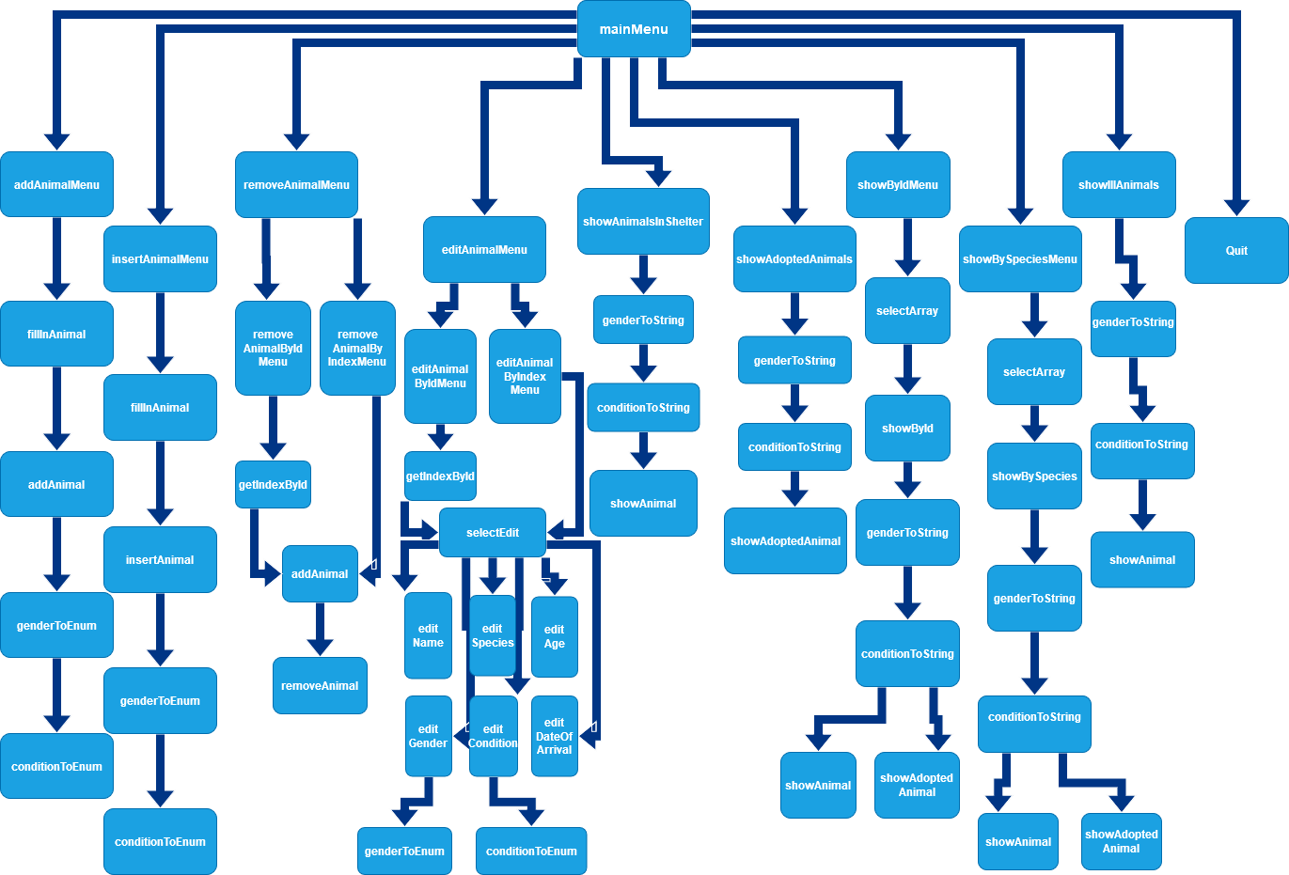

Slide 7
For the future
Add more functions
Make more tests if the entered information is valid
Improve it so we can store more information about more animals
Make the interface more visually apealing

Slide 8
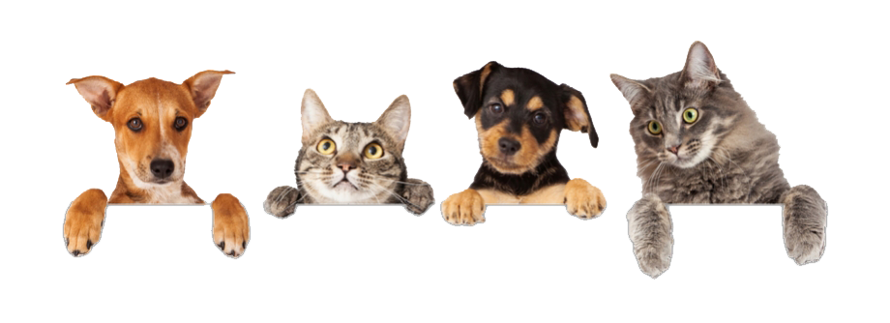
Thank you for your attention!
Any questions?

